Slide 1
Management of Perinatal and Newborn Infections
Jessie Marks DNP, ARNP

Slide 2
Learning Objectives
Understand the various risk assessment approaches for early onset sepsis and recommendations for management
Understand the management of neonatal HSV
Be able to describe recommendations for preventing perinatal HBV transmission
Understand risks for, signs of and sequelae of perinatal infections

Slide 3
Group B Streptococcus
Gram positive, beta hemolytic bacteria
It is a common colonizer of the human gastrointestinal and genitourinary tracts.
It was first recognized as causing disease in humans in the 1930s.
It can cause serious disease in young infants, pregnant women and older adults.
It emerged as the most common cause of sepsis and meningitis in young infants in the 1970s
Maternal intrapartum GBS colonization is the primary risk factor for early-onset disease in infants

Slide 4
GBS Disease
Early-onset: occurs within 24-48 hours up to first week of life causing
Bacteremia
Sepsis
Pneumonia
Meningitis
Late-onset: occurs from the first week to three months of life
Similar outcomes as early onset with meningitis being the most common.

Slide 5
Prevention of GBS Disease
In the 1980s, it was discovered that intrapartum antibiotics are highly effective in preventing mothers at risk from transmitting GBS to their newborns.
Universal screening of pregnant women at 35-37 weeks gestational age started.
Women should receive intrapartum antibiotic prophylaxis against GBS if they had:
• a GBS + screening culture
•an unknown GBS colonization status with delivery before 37 weeks, a temperature during labor greater than or equal to 100.4˚F or 38.0˚C,
or rupture of membranes for more than 18 hours
•a previous infant with GBS disease
•or GBS bacteriuria during the current pregnancy
Notes:
There are more specific guidelines for PROM and early delivery < 35 weeks gestation
Controversy around mothers who are GBS positive, who have c-section before onset of labor and rupture of membranes. Recommendations currently state no prophylaxis as risk of GBS still possible but low. Most mother after c-sections stay 48 hours, where infant can be monitored for GBS disease.
Due to current guidelines, the incidence of Early onset sepsis is 0.5 per 1,000 live births, higher prevalence in late preterm births.

Slide 6
Antibiotic recommendations
Penicillin is the preferred drug, although ampicillin is an acceptable alternative
Cefazolin is the preferred option for penicillin allergic women with low risk of anaphylaxis
With high risk of anaphylaxis, clindamycin or vancomycin is recommended

Slide 7
NAAT vs Culture
•Can do nucleic acid amplification tests (or NAAT) such as PCR for women who are GBS unknown at labor onset and have no risk factors
•Studies have found PCR for GBS to have a lower sensitivity
Positive result: Administer IAP
Negative result and patient does not develop intrapartum fever or have ROM ≥18 hours: No IAP
Negative result and patient develops intrapartum fever or has ROM ≥18 hours or < 37 weeks: Administer IAP

Slide 8
AAP Recommendations
Infants born at ≥35 0/7 weeks’ gestation can be stratified by level of risk for EOS using one of these approaches:
Category Risk Factor Assessment
Multivariate Risk Assessment
Newborn clinical condition

Slide 9
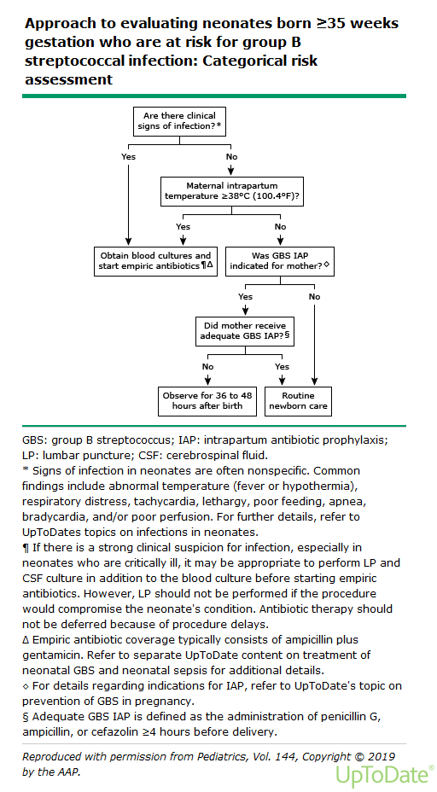
Category Risk Factor Assessment

Slide 10
Multivariate Risk Assessment Tool
Recommended tool based on cohort study of 608,000 newborns.
The objective data include:
gestational age
the highest maternal temperature
maternal GBS status
duration of ROM
type and duration of IAP.
No adverse effects during hospitalization were noted using the sepsis risk tool
Readmission of newborns due to sepsis were rare

Slide 11
Neonatal Sepsis Calculator
https://neonatalsepsiscalculator.kaiserpermanente.org/

Slide 12
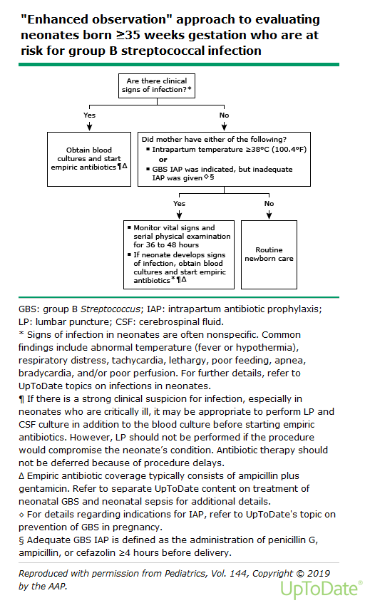
Newborn Clinical condition

Slide 13
Empiric Antibiotic therapy
The empiric antibiotic regimen should include agents active against GBS and other organisms that commonly cause neonatal sepsis.
Most common recommended course is ampicillin and gentamycin
However, local antibiotic resistance patterns must also be considered.
For all infants, regardless of gestational age:
When blood cultures are sterile, antibiotic therapy should be discontinued by 36-48 hours of incubation, unless there is clear evidence of infection.
Notes:
For culture proven sepsis or neonatal meningitis the antibiotic course is extended to 10 days for bacteremia, sepsis and pneumonia and 14 days for meningitis.

Slide 14
Cytomegalovirus
About 1 in 200 babies is born with congenital CMV infection. Of these babies, around 1 in 5 will have long-term health problems such as:
Hearing loss
Developmental and motor delay
Vision loss
Microcephaly
Seizures
About 15% of babies with congenital CMV will not have signs at birth but will later develop hearing loss.

Slide 15
Signs of Congenital CMV
10% of babies with congenital CMV infection have signs at birth.
Petechiae/purpura
Jaundice
Microcephaly
Intrauterine growth restriction
Hepatosplenomegaly
Seizures
Retinitis

Slide 16
Management of Congenital CMV
Need laboratory testing to confirm diagnosis (within 2-3 weeks from birth)
CMV PCR from urine, saliva (preferred) or blood or
CMV culture
For babies with signs of congenital CMV at birth:
Valganciclovir is recommended
Has serious side effects
May improve hearing and developmental outcomes
Newborns with congenital CMV need regular hearing and vision exams.

Slide 17
HSV infection in the newborn
Acquired during 1 of 3 distinct times:
intrauterine (in utero),
intrapartum (perinatal), 85% of transmission occurs here
postpartum (postnatal).
Five factors known to influence transmission:
Type of maternal infection (primary versus recurrent)
Maternal HSV antibody status
Duration of rupture of membranes
Integrity of mucocutaneous barriers (eg, use of fetal scalp electrodes)
Mode of delivery (cesarean versus vaginal delivery)
Primary genital HSV infection near term (higher risk due to viral shedding)
Recurrent genital HSV (lower risk)

Slide 18
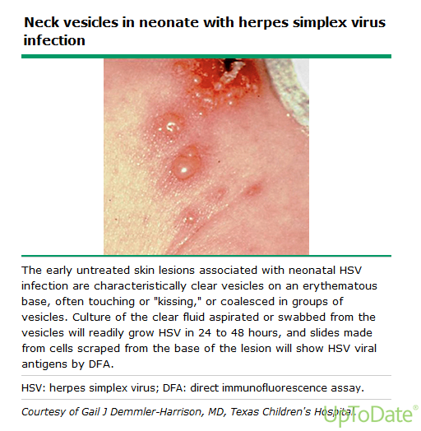
Neonatal HSV
3 categories:
localized skin, eye, and mouth disease (SEM)
CNS with or without SEM
disseminated disease

Slide 19
Clinical Manifestations of Neonatal HSV
SEM Disease:
Coalescing or clustering vesicular lesions with an erythematous base
Excessive eye watering and conjunctival erythema
HSV keratoconjunctivitis may progress to cataracts and chorioretinitis resulting in permanent vision loss
CNS Disease:
Early in course- asymptomatic
Later signs
Seizures (focal or generalized)
Lethargy
Irritability
Tremors
Poor feeding
Temperature instability
Full anterior fontanelle
Disseminated Disease
Liver: hepatitis, ascites, direct hyperbilirubinemia
Lungs: pneumonia, hemorrhagic pneumonitis
CNS
Heart: myocarditis and myocardial dysfunction
Adrenal gland and kidneys
GI tract: necrotizing enterocolitis
Skin and mucus membranes
Bone marrow and coagulation system: DIC, thrombocytopenia, neutropenia
Notes:
SEM disease accounts for approximately 45 percent of neonatal HSV
Neonatal HSV SEM disease may appear benign at onset of illness but is associated with a high risk of progression to CNS or disseminated disease if not treated. SEM disease usually presents in the first two weeks of life but may occur at any time during the first six weeks of life
Approximately one-third of neonatal HSV disease involves the CNS
Approximately one-fourth of neonatal HSV disease is the disseminated form, which is sepsis-like presentation, involving multiple organs

Slide 20
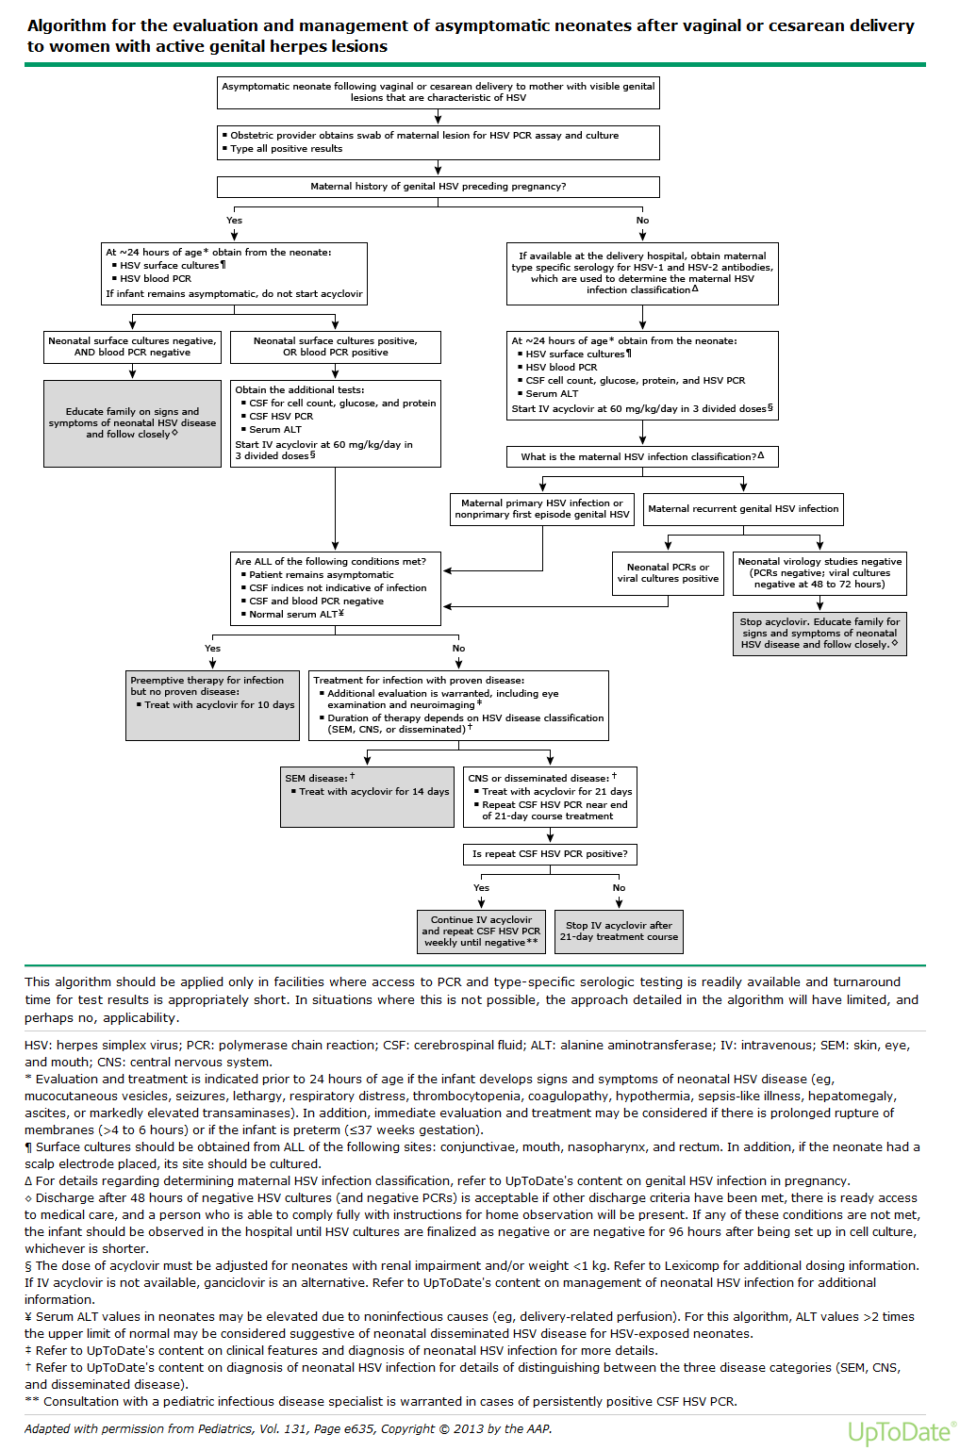

Slide 21
Hepatitis B virus
Universal screening of pregnant women for HBsAg during each pregnancy is recommended
Mother is HBsAg-positive:
Administer HepB vaccine and 0.5 mL of hepatitis B immune globulin (HBIG) (at separate anatomic sites) within 12 hours of birth, regardless of birth weight.
Test for HBsAg and anti-HBs at age 9–12 months. If HepB series is delayed, test 1–2 months after final dose.
Mother’s HBsAg status is unknown:
Administer HepB vaccine within 12 hours of birth, regardless of birth weight.
Determine mother’s HBsAg status as soon as possible. If mother is HBsAg-positive, administer 0.5 mL of HBIG to infants ≥2,000 grams as soon as possible, but no later than 7 days of age.
Notes:
Without postexposure immunoprophylaxis, approximately 40% of infants born to HBV-infected mothers in the United States will develop chronic HBV infection

Slide 22
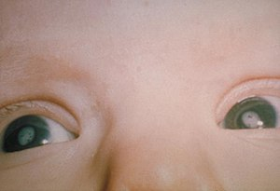
Congenital Rubella Syndrome
Cases have decreased in the US due to rubella vaccine
The risks of congenital infection and defects are highest during the first 12 weeks
Symptoms include
Cataracts
Deafness
Heart defects
IUGR
Microcephaly
Developmental delay
No treatment
Therapies focus on addressing complications

Slide 23
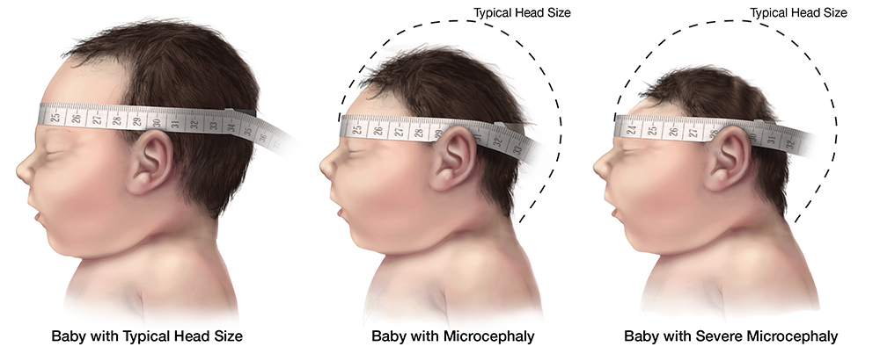
Congenital Zika Syndrome
Infants infected with Zika virus before birth
Described by the following five features:
Severe microcephaly in which the skull has partially collapsed
Decreased brain tissue with a specific pattern of brain damage
Damage to the back of the eye
Congenital contractures, such as clubfoot or arthrogryposis
Hypertonia restricting body movement soon after birth
Notes:
Perinatal transmission of Zika virus occurs when a woman is infected with the Zika virus within approximately 2 weeks of delivery, and the virus passes to the infant at or around the time of delivery. When an infant acquires Zika virus infection perinatally, the infant may develop symptoms such as maculopapular rash, conjunctivitis, arthralgia, and fever. We do not know how often perinatal Zika transmission occurs. https://www.cdc.gov/pregnancy/zika/testing-follow-up/zika-in-infants-children.html

Slide 24
Follow up care
A standard evaluation with routine preventive pediatric care and immunizations at each subsequent well-child visit
Additional eye exams as recommended by ophthalmologists
Referral for automated auditory brainstem response (ABR) testing by 1 month, if infant passed the newborn hearing screen using only the otoacoustic emissions (OAE) method
Referral to specialists for management of clinical abnormalities

Slide 25
Congenital Toxoplasmosis
From maternal infection acquired during pregnancy (symptoms may be flu-like but most are asymptomatic)
The classic triad of neonatal findings consists of chorioretinitis, hydrocephalus, and intracranial calcifications.
Severe disease can cause early death
Long term neurologic and ophthalmologic sequelae may not develop for several years
For diagnosis:
PCR of amniotic fluid
PCR of body fluids
MRI or CT of brain
Treatment:
Pyrimethamine, sulfadiazine, and leucovorin may help.
Prevention is best, education on pregnant woman to avoid cat feces

Slide 26
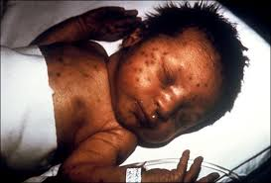
Congenital Syphilis
Can cause stillbirth or neonatal death (up to 40% of cases)
Possible sequalae:
Deformed bones
Severe anemia
Enlarged liver and spleen
Jaundice
Brain and nerve problems
Meningitis
Skin rashes

Slide 27
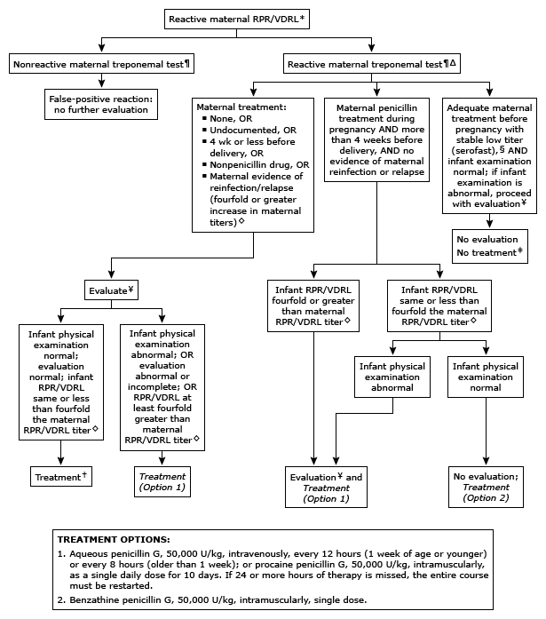
Notes:
RPR screening is recommend early in all pregnancies
Women who maintain a VDRL titer 1:2 or less or an RPR 1:4 or less beyond 1 year after successful treatment are considered serofast. ¥ Complete blood cell (CBC) and platelet count; cerebrospinal fluid (CSF) examination for cell count, protein, and quantitative VDRL; other tests as clinically indicated (eg, chest radiographs, long-bone radiographs, eye examination, liver function tests, neuroimaging, and auditory brainstem response). ‡ Some experts would consider a single intramuscular injection of benzathine penicillin (Treatment Option 2), particularly if follow-up is not certain. † Treatment (Option 1 or Option 2, above) with many experts recommending Treatment Option 1. If a single dose of benzathine penicillin G is used, then the infant must be fully evaluated, full evaluation must be normal, and follow-up must be certain. If any part of the infant's evaluation is abnormal or not performed, or if the CSF analysis is rendered uninterpretable, then a 10-day course of penicillin is required.

Slide 28
Infant exposed to maternal HIV
Vertical transmission of HIV can occur in utero, during labor or after delivery.
Up to 65% of transmission occurs during labor
The following factors increase the risk of transmission:
Maternal factors | Intrapartum events
Low CD4+ lymphocyte count High viral load Advanced AIDS Preterm delivery Chorioamnionitis Presence of p24 core antigen | Instrumental delivery Use of fetal scalp monitor Fetal scalp pH measurement Use of DeLee suctioning Artificial rupture of membranes Rupture of membranes for longer than 4 hours Other events increasing fetal exposure to maternal blood

Slide 29
Antiretroviral Prophylaxis
Zidovudine prophylaxis should be initiated as soon as possible after birth within 12 hours from delivery.
If AVR prophylaxis is initiated 24-36 hours after birth, usually not effective for preventing infection.
HIV-1 infection is established in most perinatally infected infants by 1-2 weeks.
Zidovudine (ZDV) is given orally at 2 mg/kg/dose every 6 hours for 6 weeks
IF concerned about adherence can consider 4 mg/kg/dose BID

Slide 30
Age | Action | Comment
Birth | History and physical examination; assess risk of other infections; start ARV prophylaxis; check hemoglobin level | HIV-1 NAAT is not needed at birth IF mother is taking highly active ARV therapy since 2nd trimester, virus load undetectable the week before delivery and mother received 3 hours of ZDV IV before delivery. For infant whose mother had high virus load during pregnancy, consider HIV-1 NAAT at this time
14 d | HIV-1 NAAT | If result is negative, repeat at 4 wk
4 wk | HIV-1 NAAT | If result is negative, HIV-1 infection is presumptively excluded (given previous negative result at ≥2 wk of age)
6 wk | Stop ARV prophylaxis | PCP prophylaxis is not needed if HIV-1 NAAT result is negative at 14 d and 4 wk of age
8 wk | No HIV-1 NAAT needed if previous test results were negative at 14 d and 4 wk of age | A single negative result of HIV-1 NAAT performed at 8 wk of age allows presumptive exclusion of HIV-1 infection
4 mo | HIV-1 NAAT | If negative, HIV-1 infection is definitively excluded in the infant with previous presumptive exclusion
12–18 mo | Enzyme immunoassay for antibody to HIV | To confirm the absence of HIV infection
Notes:
For maternal HIV-1 serostatus unknown, rapid HIV-1 antibody should be preformed on mother or infant ASAP. Sensitivity is better on maternal blood, preferred method.
If any positive HIV-1 NAAT result, test is promptly repeated to confirm the diagnosis of HIV-1 infection.

Slide 31
References
David W. Kimberlin et al. Pediatrics 2013;131:e635-e646
Cytomegalovirus (CMV) and Congenital CMV Infection. Centers for Disease Control and Prevention. Accessed April 24, 2021. https://www.cdc.gov/cmv/clinical/index.html
Hepatitis B. Centers for Disease Control and Prevention. Accessed April 24, 2021. https://www.cdc.gov/hepatitis/hbv/perinatalxmtn.htm
Chapter 15: Congenital Rubella Syndrome. Centers for Disease Control and Prevention. Accessed April 24, 2021. https://www.cdc.gov/vaccines/pubs/surv-manual/chpt15-crs.html
Congenital Zika Syndrome and Other Birth Defects. Centers for Disease Control and Prevention. Accessed April 24, 2021. https://www.cdc.gov/pregnancy/zika/testing-follow-up/zika-syndrome-birth-defects.html
Congenital Toxoplasmosis - Pediatrics. (n.d.). Retrieved from https://www.merckmanuals.com/professional/pediatrics/infections-in-neonates/congenital-toxoplasmosis
ALEX H. KRIST, M.D., and AMY CRAWFORD-FAUCHER, M.D., Fairfax Family Practice Residency, Virginia Commonwealth University School of Medicine, Fairfax, Virginia. Am Fam Physician. 2002 May 15;65(10):2049-2057.
American Academy of Pediatrics. Group B streptococcal infections. In: Red Book: 2018 Report of the Committee on Infectious Diseases, 31st ed, Kimberlin DW, Brady MT, Jackson MA, Long SS (Eds), American Academy of Pediatrics, Itasca, IL 2018. p.762.
Medications. In: Guidelines for Acute Care of the Neonate, 26th Ed, Fernandes CJ, Pammi M, Katakam L (Eds), Baylor College of Medicine, Houston, TX 2018. p.228.
Puopolo KM, Lynfield R, Cummings JJ, et al. Management of Infants at Risk for Group B Streptococcal Disease. Pediatrics 2019; 144.
HIV and Pregnant Women, Infant and Children. Centers for Disease Control and Prevention. Accessed April 24, 2021. https://www.cdc.gov/hiv/group/gender/pregnantwomen/

